Slide 1
CSH301-Industry 4.0 HighRadius Internship
Korrayi Karthik
Intern ID: HRC72065W
College Reg. ID: 11912804

Slide 2
Training Certificate

Slide 3

Introduction of the Company
HighRadius offers cloud-based Autonomous Software for the Office of the CFO. More than 700 of the world’s leading companies have transformed their order to cash, treasury and record to report processes with HighRadius. Customers include 3M, Unilever, Anheuser-Busch InBev, Sanofi, Kellogg Company, Danone, Hershey’s

Slide 4
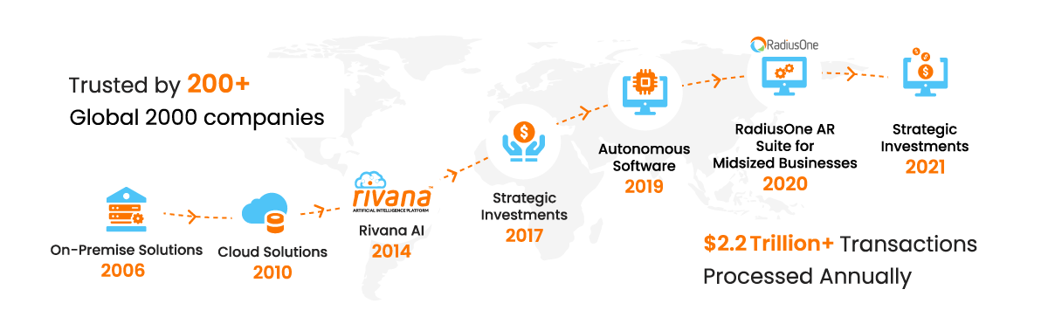
Origin and Growth of the Company
Co-founded in 2006 by Indian-origin entrepreneur Sashi Narahari, it remained bootstrapped until its first funding round in 2017.
It is trusted by some of the world’s largest corporations and is consistently named one of the fastest growing technology companies in Houston, where it is headquartered.

Slide 5
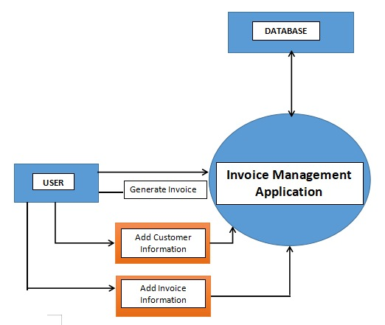
Introduction of the project undertaken
AI-Enabled FinTech B2B Invoice Management Application

Slide 6
Implementation
ML Implementation
Back-End Implementation
Front-End Implementation

Slide 7
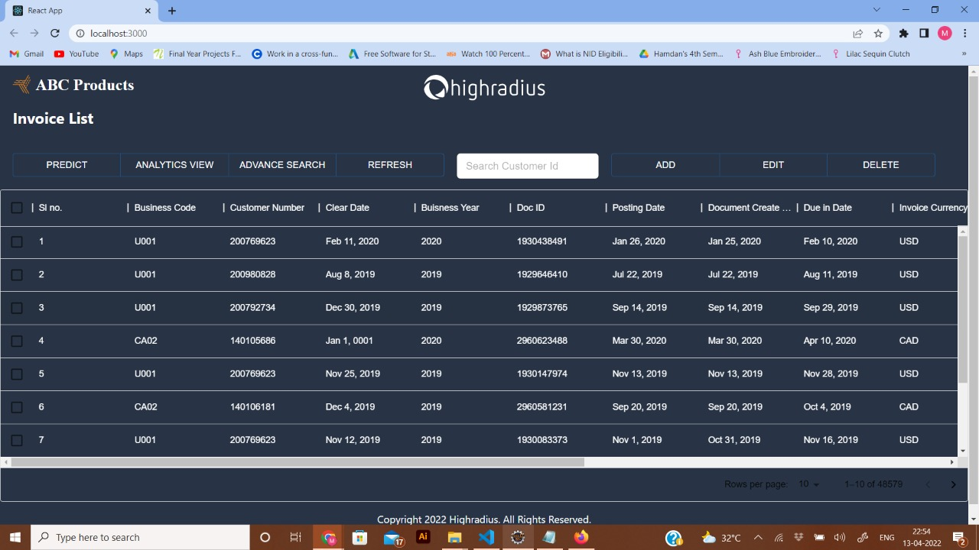
UI of Receivable Dashboard page

Slide 8
Challenges faced
In order to achieve this, there should be a button named “Predict” present on the UI besides the “Advance Search” button.
Users can select one or more invoices and click on the “Predict” button to predict the payment dates of those selected invoices.
Once the button is clicked, the Predicted Payment Date column should get populated with the predicted dates derived from the ML model.
The “Predict” button should remain disabled if no invoices are selected.

Slide 9
Conclusion
The main purpose of the project is to manage the Account Receivable department in a straightforward, smooth and efficient way.
The account managers will be able to collect payments from customers for their past due invoices.
Reminders and follow ups can be sent to the customers for payments to be made in a timely manner.
They can look after the entire process of getting the cash inflow and also help the company get paid for the services and products supplied.

Slide 10
Thank You!

